Slide 1
Resource planning tools
Submitted by:
Shweta(747925)

Slide 2
Introduction
It is a software through we can plan our resource allocation, schedule (and reschedule) different tasks which finally helps to improve the resource efficiency and helps to complete the project on time.

Slide 3
Contents to be Discussed
eResource Scheduler
Its Features:
Amazing Dashboard
Powerful Scheduling Chart
Configurability
User Access Rights
Other Features
Conclusion

Slide 4
eResource Scheduler
It is a resource management software which has the following characteristics:
Cloud Based
Drag n Drop Planning
Powerful Reports

Slide 5
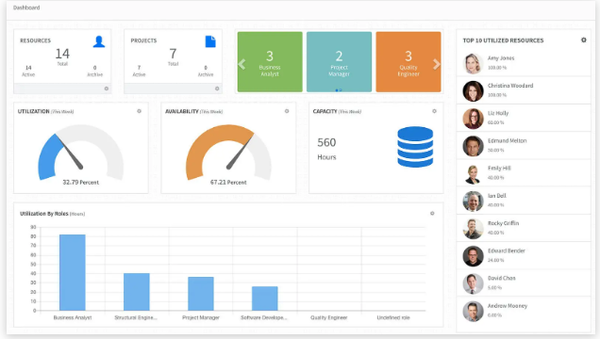
Amazing Dashboard
Different types of widgets
show the contents like project
count, resource count,
availability etc. and it can be
configured in different units

Slide 6
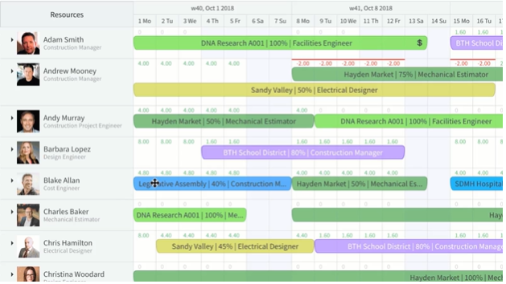
Powerful scheduling chart
With the help of this ,it becomes
easy to understand when the
resources are scheduled on
projects and when they are
available. Also, we can drag
n drop the contents

Slide 7
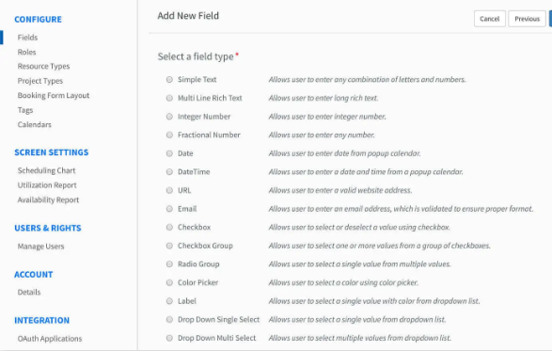
CONFIGURABILITY
It ensures that organizations
of all types and sizes are able to
customize according to their
requirements.

Slide 8
User Access rights
To maintain data confidentiality, there are different data rights according to
individual requirements

Slide 9
Other features
Management Reports-Utilization and Availability
Open REST API

Slide 10
Conclusion
All in All , it’s a software which provides flexibility to its different features which allow us to make changes time to time. So ,that we can effectively utilize our resources in terms of time and money.

